Slide 1
Introduction to Algorithms
Md. Muktar Hossain
Lecturer
Dept. of CSE
Varendra university

Slide 2
Definition
A procedure for solving a mathematical problem in a finite number of steps.
An algorithm is a set of instructions that are followed to complete a task or solve a problem.
An algorithm is a set of defined steps designed to perform a specific objective.
Set of rules to obtain expected output from given input
Input
Output

Slide 3
Applications
Computer Science: Computer programming, Artificial intelligence and Machine learning etc.
Mathematics: Optimal solution to a system of linear equations or the shortest path in a graph.
Operations Research: Transportation, Logistics, and Resource allocation.
Data Science: Analyze, Process, and Extract insights from large amounts of data in fields such as Marketing, Finance, and Healthcare.

Slide 4
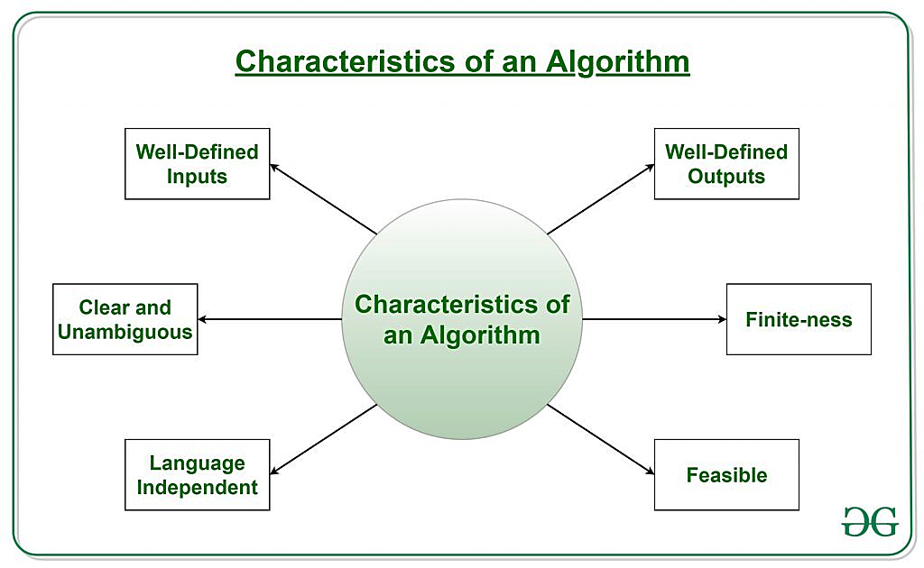
Characteristics
It should terminate after a finite time.
It should produce at least one output.
It should take zero or more input.
It should be deterministic means giving the same
output for the same input case.
Every step in the algorithm must be effective
i.e. every step should do some work.

Slide 5
Design and Analysis
Design: Focuses on creating algorithms to solve a specific problem.
Understanding the Problem
Choosing a Strategy
Developing the Algorithm
Verification
Analysis: Focuses on evaluating the performance and efficiency of an algorithm.
Correctness
Complexity Analysis
Best/Worst/Average Case Analysis
Comparative Analysis

Slide 6
Design and Analysis Cont’d
How to Design an Algorithm?
The problem that is to be solved by this algorithm i.e. clear problem definition.
The constraints of the problem must be considered while solving the problem.
The input to be taken to solve the problem.
The output is to be expected when the problem is solved.
The solution to this problem is within the given constraints.

Slide 7
Design and Analysis Cont’d
How to Analyze an Algorithm?
Priori Analysis: It means checking the algorithm before its implementation.
Posterior Analysis: It means checking the algorithm after its implementation.
Correctness
Space Complexity
Time Complexity

Slide 8
Complexity Analysis
Two factors (time and space) define the efficiency of an algorithm.
Time Complexity: Refers to the amount of time required by the algorithm to execute and get the result.
T(P) = C + V
Constant Time Part (C): Any instruction that is executed just once comes in this part.
Variable Time Part (V): Any instruction that is executed more than once, say n times, comes in this part.

Slide 9
Complexity Analysis Cont’d
Two factors (time and space) define the efficiency of an algorithm.
Space Complexity: Refers to the amount of memory required by the algorithm to store the variables and get the result.
S(P) = C + V
Fixed Part (C): The space that is required by the algorithm.
Variable Part (V): The space that can be different based on the implementation of the algorithm. For example, temporary variables, dynamic memory allocation, recursion stack space, etc.

Slide 10
Advantages vs Disadvantages
Advantages:
Easy to understand
Serve as a blueprint
Simple to debug
Not dependent on programming language
Disadvantages:
Time-consuming
Space and time complexity
Branching and Looping statements are difficult to show in Algorithms

Slide 11
Thank You

